Slide 1


Python
Mr. Ankit Raj
Corporate Trainer-CETPA Group of Companies

Slide 2
Brief About Company
20+ Years Old Ed-Tech Group, working in Training, Development & Placement domains.
Providing Industrial training in 150+ Technologies through corporate experts.
Having Company Owned Multiple Campuses with Corporate Office at Noida.
ISO 9001:2015 Certified Company
Delivered Training to 2,00,000+ Students.
100% Placement assistance.
CETPA’s own Placement wing with 500+ Tie ups all over PAN India.
Being into Development wing, opportunity to work on Live Projects
TRAINING
DEVELOPMENT
PLACEMENT

Slide 3
Introduction
Why Python
Programming Interface
Variables & Data Types
Conditions(If Else)
Debugging in conditions
Nested Conditions
Loops
Range Function in Loop
List
Tuple
Dictionary
Set
Functions
Course Outline

Slide 4
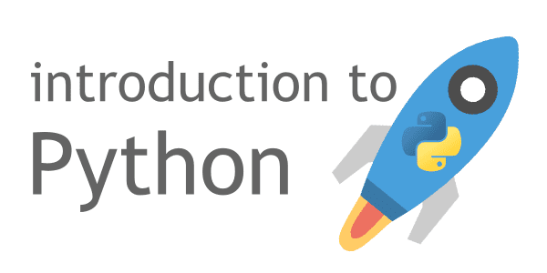
INTRODUCTION
Python is a computer programming language often used to build websites and software, automate tasks, and analyze data.
Python is an interpretive language.
It was created by Guido van Rossum, and released in 1991.

Slide 5
Python can be used on a server to create web applications.
Python can be used alongside software to create workflows.
Python can connect to database systems. It can also read and modify files.
Python can be used to handle big data and perform complex mathematics.
Python can be used for rapid prototyping, or for production-ready software development.
Why Python?

Slide 6
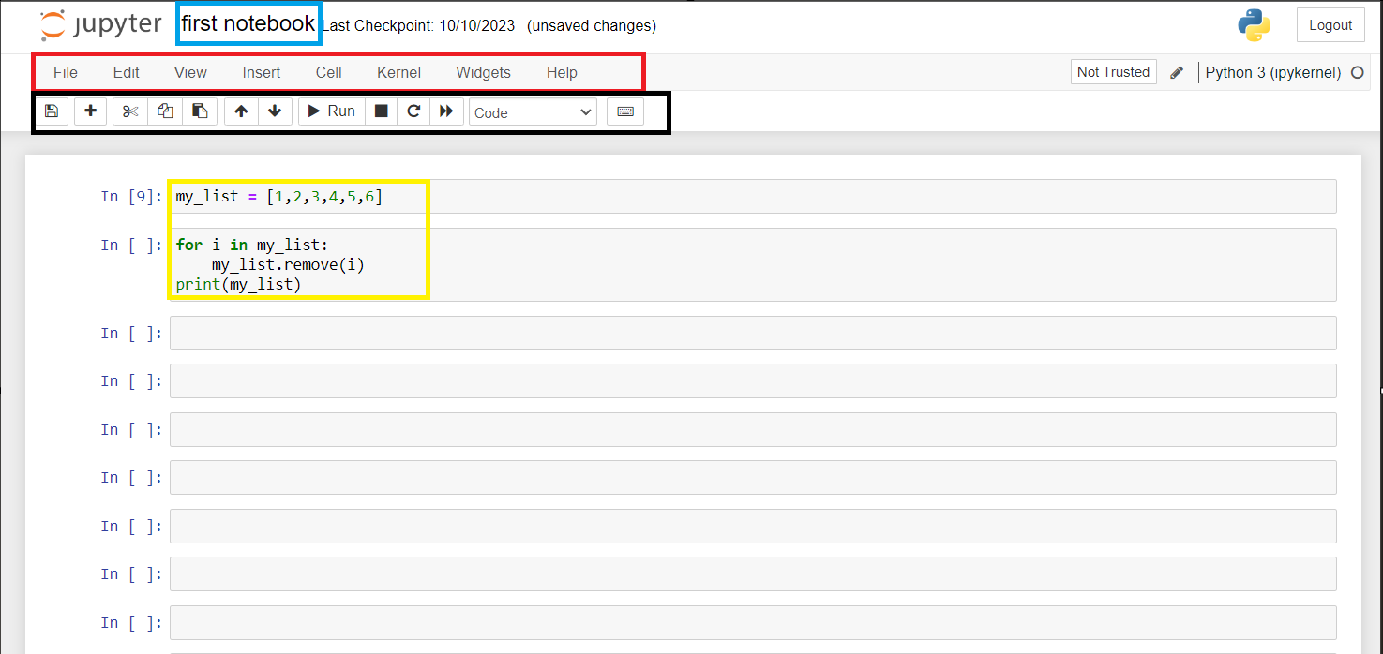
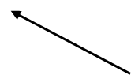
Python Interface

Slide 7
Variables → An abstract storage location paired with an associated symbolic name, which contains some known or unknown quantity of data or object referred to as a value. Ex → x = 4, a = ‘Python’
Data Types → The type of value a variable has and what type of mathematical, relational or logical operations can be applied without causing an error.
Types
Int
Float
String
Complex Boolean
Variables & Data Types

Slide 8
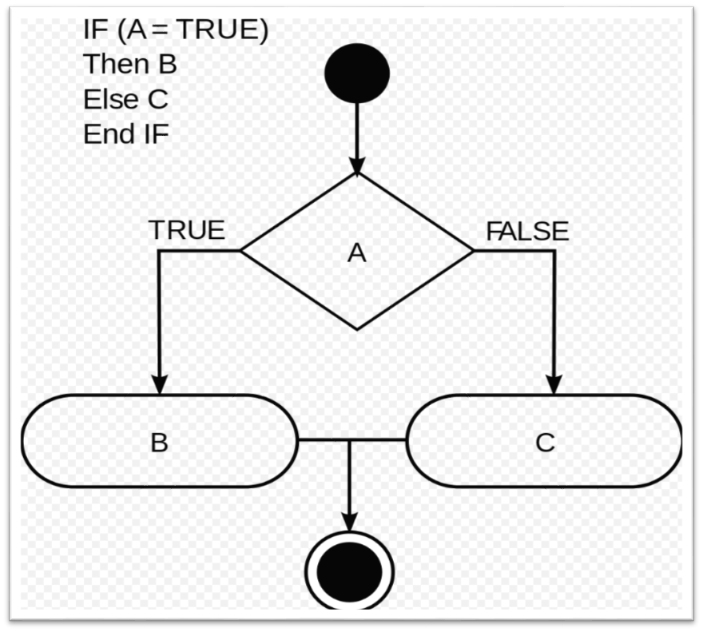

Slide 9
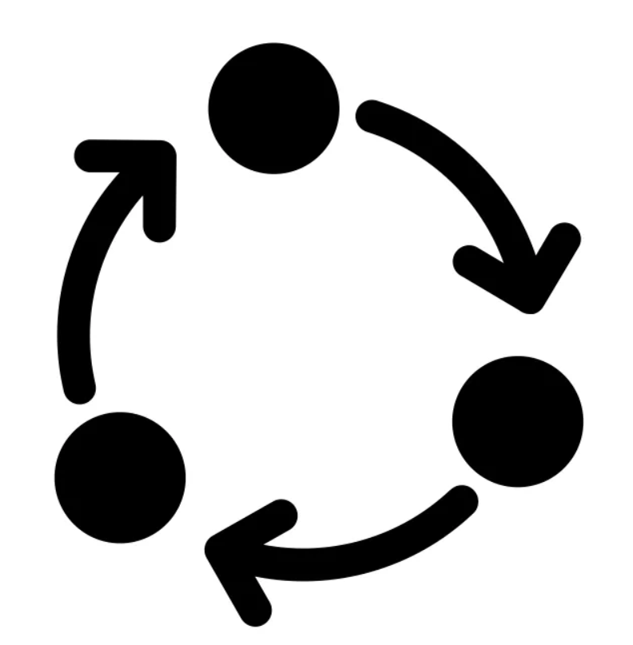
Loop

Slide 10
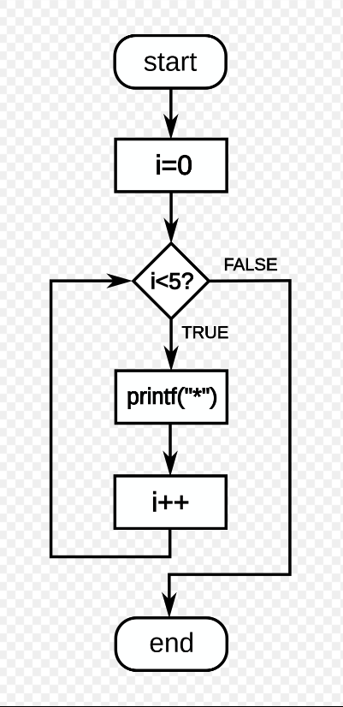
Structure of Loop

Slide 11
Type of Loop
For Loop
While Loop
Difference between For & While Loop
Range Function
Operators

Slide 12
Lists are used to store multiple items in a single variable.
List items are ordered, changeable, and allow duplicate values.
The list is changeable, meaning that we can change, add, and remove items in a list after it has been created.
Ex → thislist = ["apple", "banana", "cherry", "apple", "cherry"] print(thislist)
List

Slide 13
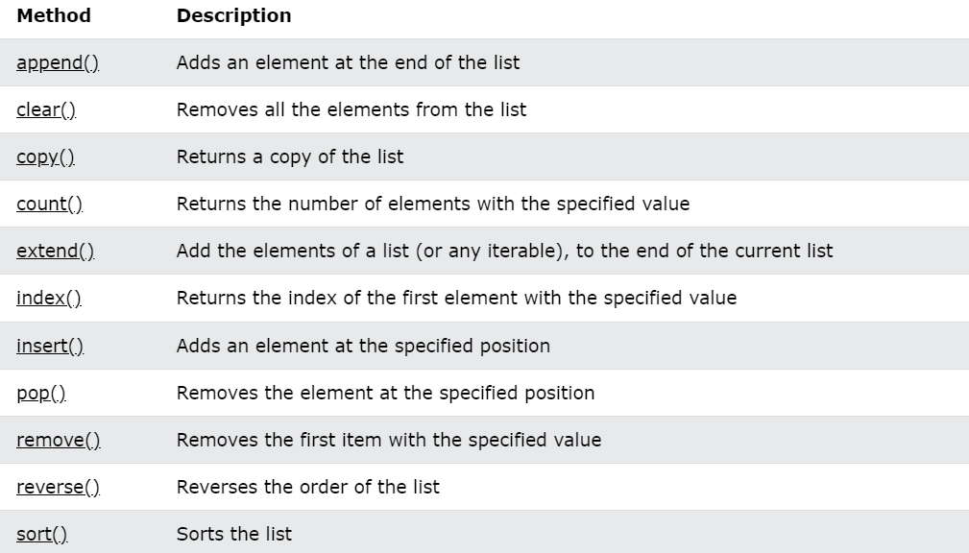
Function of List

Slide 14
Dictionary
Dictionaries are used to store data values in key: value pairs.
A dictionary is a collection which is ordered*, changeable and do not allow duplicates.
Dictionaries are written with curly brackets, and have keys and values:
Ex → thisdict = { "brand": "Ford", "model": "Mustang", "year": 1964 } print(thisdict)

Slide 15
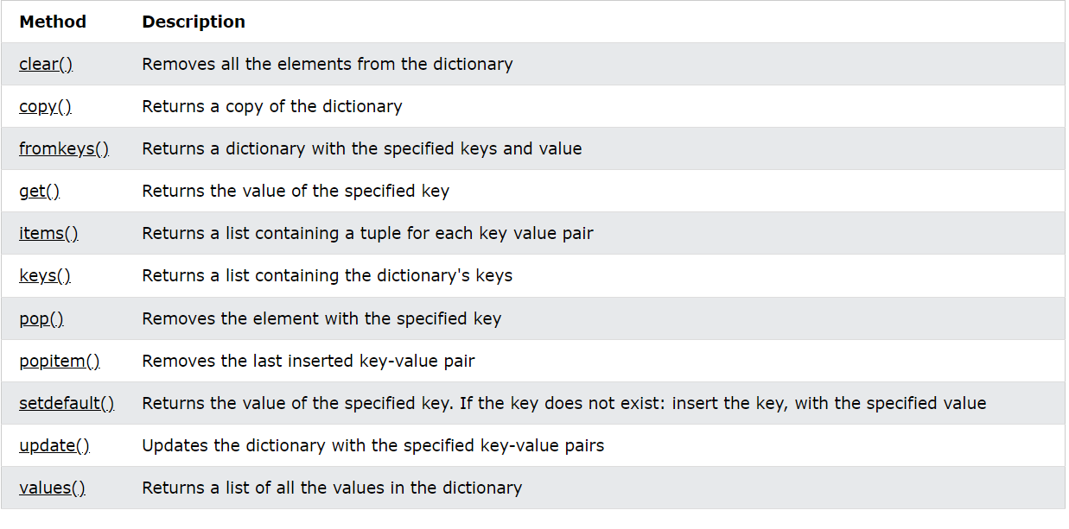
Function of Dict

Slide 16
Tuple
Tuples are used to store multiple items in a single variable
A tuple is a collection which is ordered and unchangeable.
Tuples are written with round brackets.
Example →thistuple = ("apple", "banana", "cherry", "apple", "cherry") print(thistuple)

Slide 17
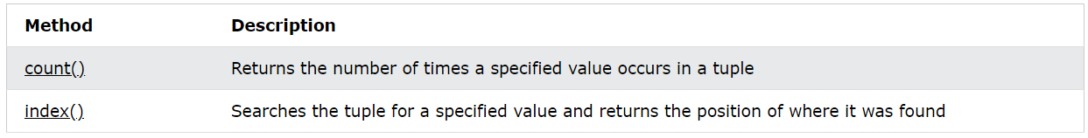
Tuple

Slide 18
Set
Sets are used to store multiple items in a single variable.
A set is a collection which is unordered, unchangeable*, and unindexed.
Sets are written with curly brackets.
Sets cannot have two items with the same value.
thisset = {"apple", "banana", "cherry", "apple"} print(thisset)

Slide 19
add ()
clear()
Pop()
Remove()
SET Methods :

Slide 20
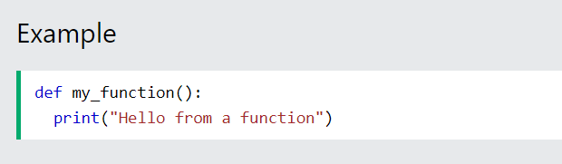
Function in Python:
A function is a block of code which only runs when it is called.
You can pass data, known as parameters, into a function.
A function can return data as a result.
In Python a function is defined using the def keyword.

Slide 21
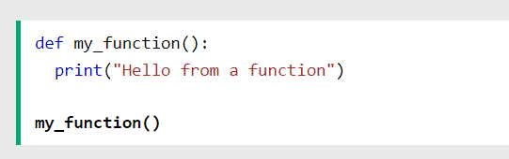
Calling A Function
To call a function, use the function name followed by parenthesis:

Slide 22
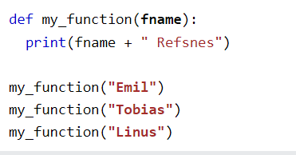
Arguments
Information can be passed into functions as arguments.
Arguments are specified after the function name, inside the parentheses.
You can add as many arguments as you want, just separate them with a comma.
When the function is called, we pass along a first name, which is used inside the function to print the full name:

Slide 23
Python Slide Type 2

Slide 24
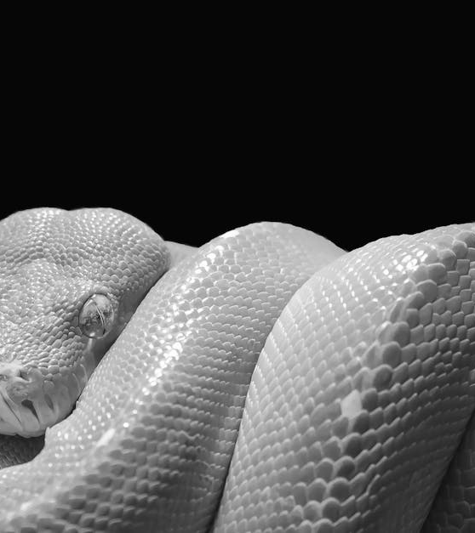
Python
Presentation by Your Name

Slide 25
Introduction to Python
What is Python
Significance in Programming World
Usage of Python
Python is a high-level, interpreted programming language known for its simplicity and readability. It is widely used in various domains such as web development, data analysis, artificial intelligence, and more. Python's design emphasizes code readability and its syntax allows programmers to express concepts in fewer lines of code.
Python is used for developing web applications, scientific computing, artificial intelligence, data analysis, and more. Its ease of use and extensive libraries make it a popular choice for beginners as well as experienced programmers. Python is also widely adopted in the field of machine learning and automation.
Python has gained immense popularity due to its simplicity, versatility, and strong community support. It has a vast ecosystem of libraries and frameworks which make it suitable for a wide range of applications. Its simplicity and readability have led to increased productivity and creativity in programming projects.

Slide 26
Python Features
Simplicity
Libraries
Versatility
Python's syntax is clear and easy to read, making it an ideal language for beginners and experienced programmers alike. The language encourages developers to write clean, maintainable code by enforcing a consistent style and philosophy.
Python is suitable for a wide range of applications, from web development to scientific computing and machine learning. It provides a flexible environment for developers to express their ideas and solve complex problems in a concise manner.
Python has a rich collection of libraries and frameworks that offer pre-written code modules for various tasks, allowing developers to focus on solving the specific problem at hand. This extensive ecosystem enhances Python's capabilities and accelerates development.

Slide 27
Python Applications
Web Development
Machine Learning
Data Analysis
Python is widely used for web development due to its simplicity, vast libraries, and excellent integration capabilities. Popular frameworks like Django and Flask make it easier to build scalable and secure web applications.
Python is favored by data scientists and analysts for its powerful libraries such as Pandas, NumPy, and Matplotlib, which enable efficient data manipulation, visualization, and statistical analysis.
Python has become the language of choice for machine learning and artificial intelligence projects. Libraries like TensorFlow, Keras, and scikit-learn provide powerful tools for developing and deploying machine learning models.

Slide 28
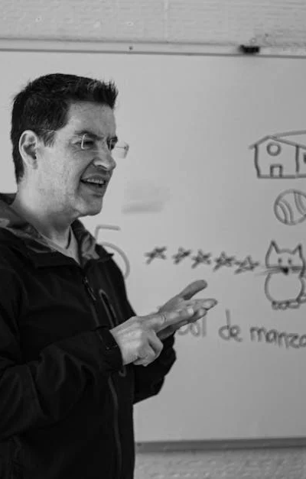
Python Syntax
Clean and Readable Syntax
Expressive and Concise
Python's syntax is designed to be simple and readable, which makes it easier for developers to understand and maintain code. It emphasizes the use of whitespace and is known for its clear and intuitive structure, enhancing code readability and reducing development time.
Python's expressive nature allows developers to accomplish more with less code. Its clear and natural language constructs enable the creation of powerful and efficient solutions while maintaining a focus on readability and maintainability.

Slide 29
Python Community and Resources
Vibrant Community
Python has a vibrant and active community of developers, enthusiasts, and contributors. There are numerous forums, user groups, and conferences dedicated to Python, offering ample opportunities for learning, collaboration, and networking.
Abundant Resources and Support
Python offers a wealth of resources, including extensive documentation, tutorials, and online courses. Additionally, there are dedicated forums, mailing lists, and social media groups where developers can seek help, share knowledge, and contribute to the growth of the Python ecosystem.

Slide 30

Conclusion
Embracing Python
Python's simplicity, versatility, and robust community make it an indispensable tool for developers across various domains. It empowers creativity, accelerates development, and fosters innovation. Encouraging further exploration of Python will lead to continuous learning and discovery of its evolving capabilities.

